Slide 1
Chapter 3 figures

Slide 2
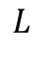
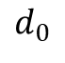
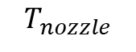
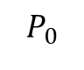
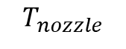
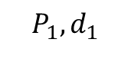
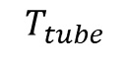
$$P_{1},d_{1}$$
$$T_{nozzle}$$
$$T_{nozzle}$$
$$d_{0}$$
$$L$$
$$T_{tube}$$
$$P_{0}$$

Slide 3
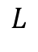
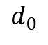
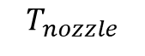
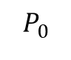
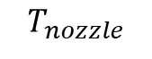
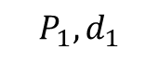
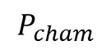
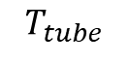
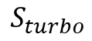
$$S_{turbo}$$
$$P_{cham}$$
$$P_{1},d_{1}$$
$$T_{nozzle}$$
$$T_{nozzle}$$
$$d_{0}$$
$$L$$
$$T_{tube}$$
$$P_{0}$$

Slide 4

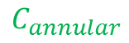
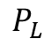
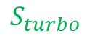

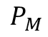
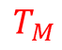
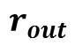
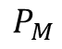
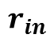
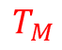
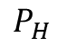

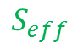
$$S_{turbo}$$
$$P_{L}$$
$$P_{M}$$
$$P_{H}$$
$$P_{M}$$
$$T_{M}$$
$$T_{H}$$
$$T_{H}$$
$$T_{M}$$
$$C_{annular}$$
$$C_{annular}$$
$$r_{in}$$
$$r_{out}$$
$$S_{eff}$$

Slide 5
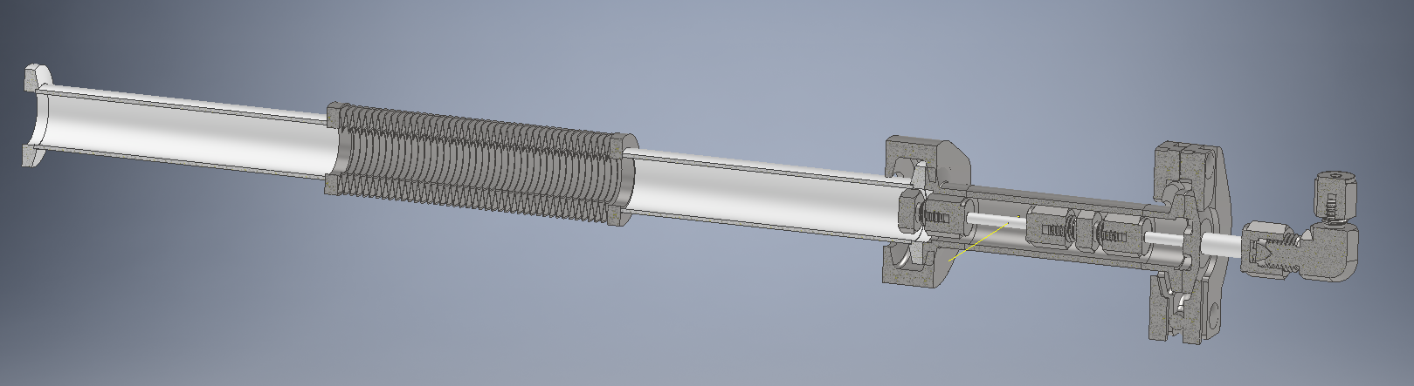
Chamber wall
Exhaust to RV pump
Edge-welded bellows
Interaction region
Gas source
laser

Slide 6
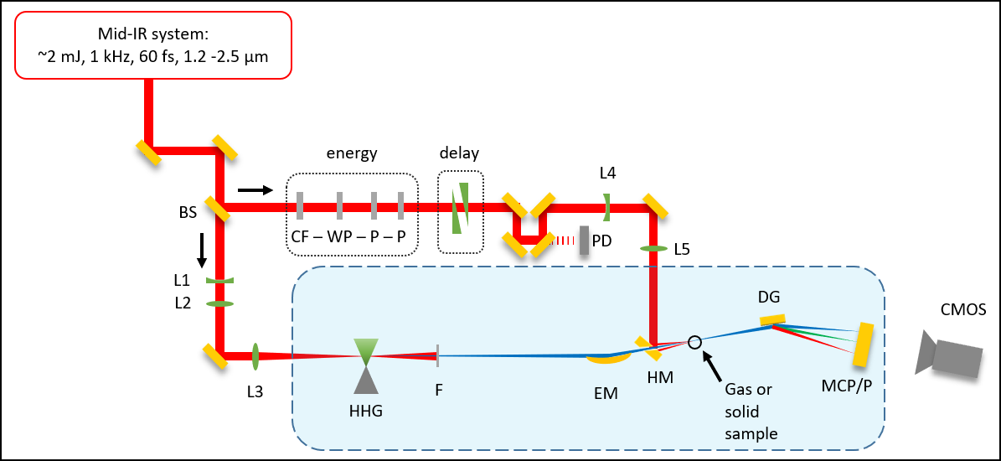
Beamline cartoon (image)
S
S

Slide 7


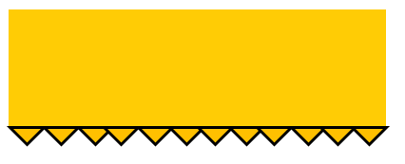
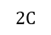
Beamline cartoon (editable)
Mid-IR system:
~2 mJ, 1 kHz, 60 fs, 1.2 -2.5 μm
energy
delay
S
L4
BS
CF – WP – P – P
S
W
PD
L5
L1
DG
L2
CMOS
I
L3
$$2C$$
HHG
F
EM
HM
SH
MCP/P

Slide 8
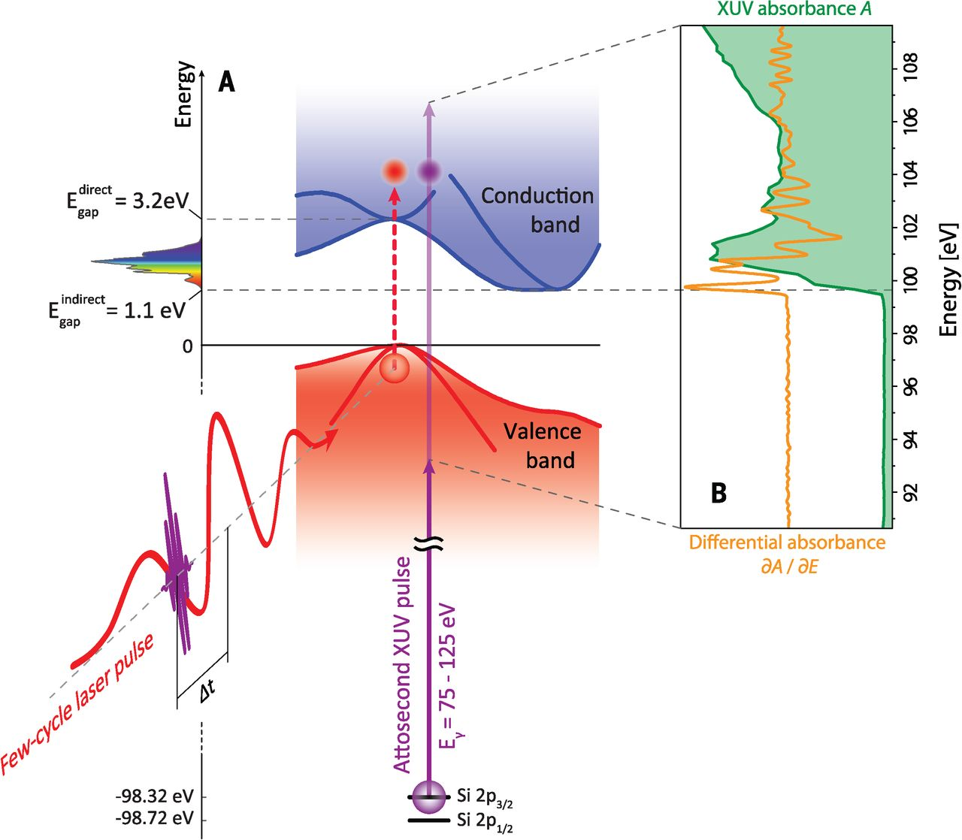

Slide 9
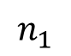
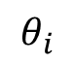
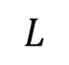
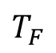
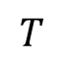
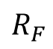
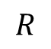
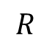
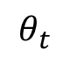
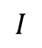
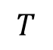
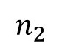
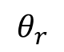
Fresnel geometry
a)
b)
$$L$$
$$T$$
$$I$$
interface
$$T_{F}$$
$$θ_{i}$$
normal
$$R$$
$$θ_{r}$$
$$θ_{t}$$
$$R$$
$$T$$
$$R_{F}$$
$$n_{1}$$
$$n_{2}$$

Slide 10
7.5 mm
3 mm
100 nm Ge
30 nm SiNx
500 μm Si
7.5 mm
3 mm
100 nm Ge
30 nm SiNx
500 μm Si
Notes:
Sample_Geometry.png

Slide 11
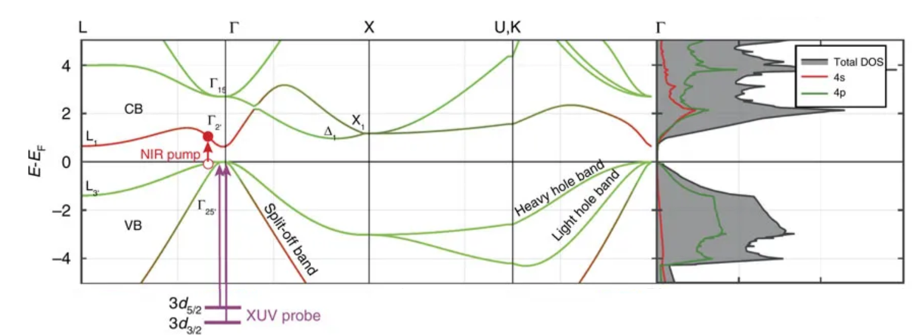

Slide 12
Knife edge cartoon
XUV
XUV detector

Slide 13
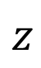
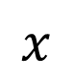
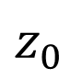
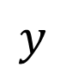
Knife edge cartoon
$$y$$
EM
$$z$$
$$x$$
XUV
XUV detector
$$z_{0}$$

Slide 14
Imaging the samples under vacuum
C
1 inch
HM
FM
SH
1 inch
L

Slide 15
Si, 260 nm
Si, one hole <200μm
“popped” 30 nm SiN

Slide 16



200 nm Si
200 nm Si
200 nm Si
IR-pumped areas
microscope image
Notes:
Figures from 2019-04-19 powerpoint presentation … “before pumping” was 4/09/2019 map1. “after pumping” was 4/10/2019 map1.

Slide 17



2D spectrometer image
Raw 2D image
Spectral lineout
Filtering
Delta-OD calculation
Delta-OD normalization
Average delta-OD
Energy calibration
Background subtraction, exposure time normalization, normalized spatial integration,

Slide 18
Finding temporal overlap in vacuum (or vented)
PA
HM
FM
GA
SH
L
C

Slide 19
Si, 260 nm
Si, one hole <200μm
“popped” 30 nm SiN
200 nm Si
200 nm Si
200 nm Si
IR-pumped areas
microscope image
Notes:
Figures from 2019-04-19 powerpoint presentation … “before pumping” was 4/09/2019 map1. “after pumping” was 4/10/2019 map1.

Slide 20


Slide 21

Germanium bandgap
M. Zürch, Nat. Commun. 8, no. 1, 15734 (2017)

Slide 22
Germanium bandgap
M. Zürch, Nat. Commun. 8, no. 1, 15734 (2017)

Slide 23
Germanium bandgap
M. Zürch, Nat. Commun. 8, no. 1, 15734 (2017)

Slide 24




$$λ=1.5 μm$$
Notes:
20 mW = 20 mJ = 3.6 * 10^12 W/cm2
35 mJ = 6.3 * 10^12 W/cm2

